Slide 1
Android & Mobile Device Power Management
Zonghua Gu

Slide 2
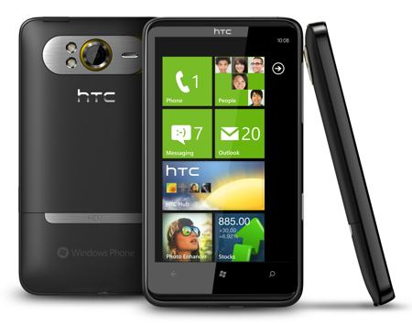
Smartphone is Energy Constrained
Energy: One of the most critical issues in smartphones
Limited battery lifetime
Battery energy density only doubled in last 15 yrs
Smartphone capability has increased drastically
Multiple Components: GPS, 3G, retina display, ….

Slide 3
Application holds wakelock on power state
If no wakelocks are held, Android powers down
Ex:
PARTIAL_WAKE_LOCK
CPU on, screen off, keyboard off
SCREEN_DIM_WAKE_LOCK
CPU on, screen dim, keyboard off
SCREEN_BRIGHT_WAKE_LOCK
CPU on, screen bright, keyboard off
FULL_WAKE_LOCK
CPU on, screen on, keyboard bright

Slide 4
Wakelock Example
PowerManager pm = (PowerManager) GetSystemService (Context.POWER_SERVICE);
PowerManager.WakeLock wl = pm.newWakeLock(PowerManager.SCREEN_DIM_WAKE_LOCK, “tag”);
wl.acquire();
//..screen stays on here
wl.release();

Slide 5
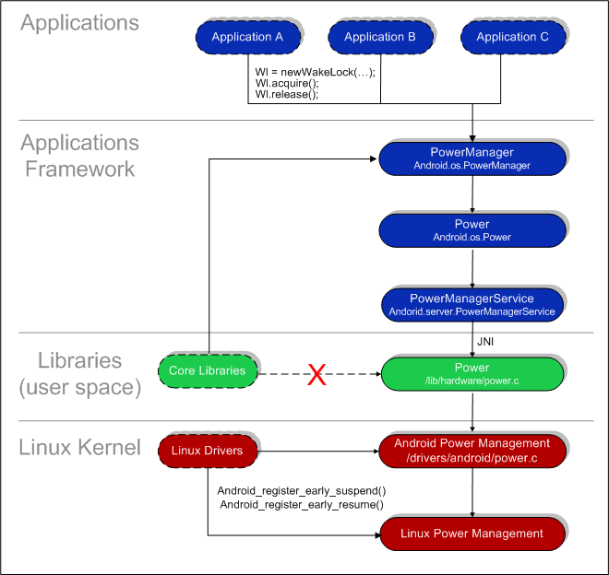
Android PM Architecture

Slide 6
Wake Locks
A locked wakelock, depending on its type, prevents the system from entering suspend or other low-power states.
There are two settings for a wakelock:
WAKE_LOCK_SUSPEND: prevents a full system suspend.
WAKE_LOCK_IDLE: prevents low-power states from being entered from idle.
Notes:
, which often cause large interrupt latencies or that disable a set of interrupts, will not be entered
until the wakelocks are released.

Slide 7
PM Procedures
All power management calls follow the same basic format:
Acquire handle to the PowerManager service.
Create a wake lock and specify the power management flags for screen, timeout, etc.
Acquire wake lock.
Perform operation (play MP3, open HTML page, etc.).
Release wake lock.
PowerManager pm = (PowerManager)mContext.getSystemService( Context.POWER_SERVICE);
PowerManager.WakeLock wl = pm.newWakeLock( PowerManager.SCREEN_DIM_WAKE_LOCK | PowerManager.ON_AFTER_RELEASE, TAG);
wl.acquire();
// ...
wl.release();

Slide 8
Research Paper on PM
Abhinav Pathak, et al,
Where is the energy spent inside my app? Fine Grained Energy Accounting on Smartphones with Eprof, Eurosys 2012
Fine Grained Power Modeling for Smartphones Using System Call Tracing, Eurosys 2011

Slide 9
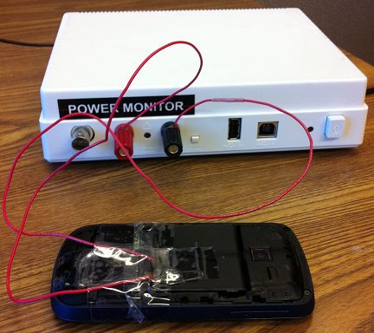
Towards Understanding Energy Drain
Key Question: Where is energy being spent?
Which component/process/thread/function(?)
Approach 1: Use Power Meter
Buy an expensive equipment ($770)
Problems:
Only reports entire device energy consumption
Approach 2 : Develop Online Power Models

Slide 10

Generic Power Modeling
Triggers
Triggers
Actual Power Consumption
Power meter
Predicted Power
Consumption
Training
Phase
Prediction
Phase
Model
Notes:
Make fonts large
Blue color not visible
Put down LR somewhere

Slide 11
Smartphone Power Modeling State-of-Art: Utilization Based (1/2)
Triggers
Utilization
Triggers
Utilization
Actual Power Consumption
Power meter
Predicted Power
Consumption
Training
Phase
Prediction
Phase
Model
Linear Regression (LR) and Superimposition
Model = (Util_{Net})* E_{Net} + (Util_{CPU})* E_{CPU} + (Util_{Disk})* E_{Disk}

Slide 12

Smartphone Power Modeling State-of-Art: Utilization Based (2/2)
Model = (Util_{Net})* E_{Net} + (Util_{CPU})* E_{CPU} + (Util_{Disk})* E_{Disk}
Fundamental (yet intuitive) assumption (Only active) Utilization => power consumption
Second assumption Energy scales linearly with amount of work
Third assumption Components power consumption add linearly
Hard to correlate energy with its consumers: which process/thread/function?
New ‘exotic’ devices do not have quantitative utlization (Ex. Camera/GPS)
Notes:
Opening/closing sockets cost energy
Devices do interact in terms of energy
Energy does not scale linearly
System calls that do not imply utilization can change
power states.Many systems calls that do not imply high utilization
of components can send the components to high or
low power states. This could be due to power optimizations
programmed in device drivers. For example, on windows
mobile, file open, close, create, delete system calls trigger
a power level change in the sdcard device driver; after these
calls the component remains in a high power state for a few
seconds. Figure 1(a) gives the example of file open on the
touch phone. Similarly, a socket close system call immediately
ends the high tail power state of the NIC on windows
mobile touch smartphones, shown in Figure 1(d). Such low
level power optimizations are typically done in the device
drivers and they also break the utilization-power-state correlation
assumption in utilization-based power models.

Slide 13
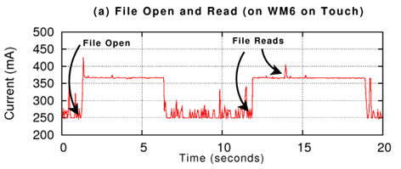
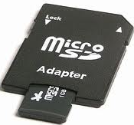
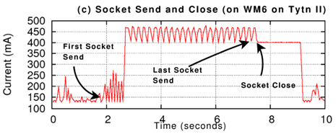
(Only active) Utilization => Power Consumption
File open/delete/ close/create change power state
Several components have tail states (3G, disk, wifi, gps)
(a) Systems calls that do not imply high utilization of components can send the components to high or low power states, due to power optimizations programmed in device drivers.
(c)Device stays at high power state for a period of time after active I/O activities, even when device is idle
Notes:
After socket close at time 8, power consumption for <2 seconds.
System calls that do not imply utilization can change
power states.Many systems calls that do not imply high utilization
of components can send the components to high or
low power states. This could be due to power optimizations
programmed in device drivers. For example, on windows
mobile, file open, close, create, delete system calls trigger
a power level change in the sdcard device driver; after these
calls the component remains in a high power state for a few
seconds. Figure 1(a) gives the example of file open on the
touch phone. Similarly, a socket close system call immediately
ends the high tail power state of the NIC on windows
mobile touch smartphones, shown in Figure 1(d). Such low
level power optimizations are typically done in the device
drivers and they also break the utilization-power-state correlation
assumption in utilization-based power models.

Slide 14
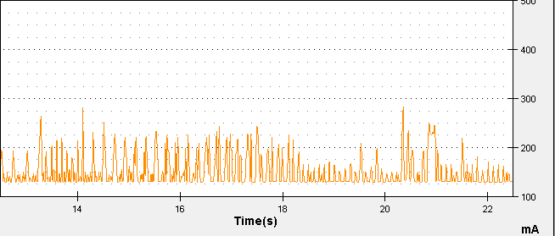
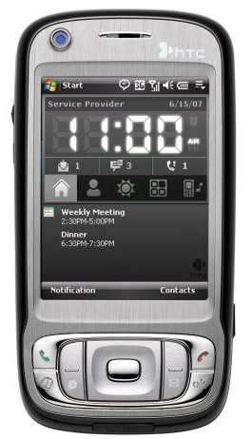
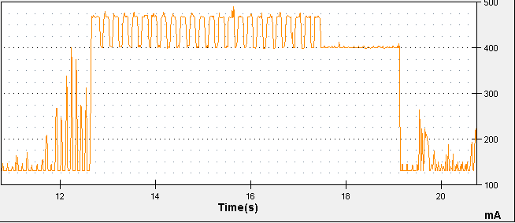
Energy scales linearly with amount of work
(1) Send packets
@ < 50pkts/s
+100-125mA
(2) Send packets
@ > 50pkts/s
+325mA
WM6.5 on Tytn II

Slide 15
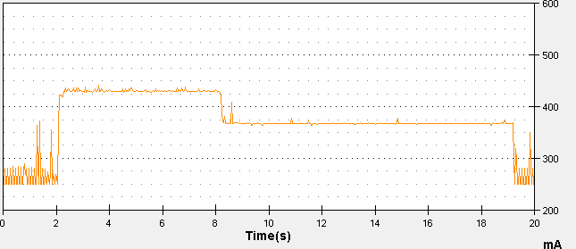
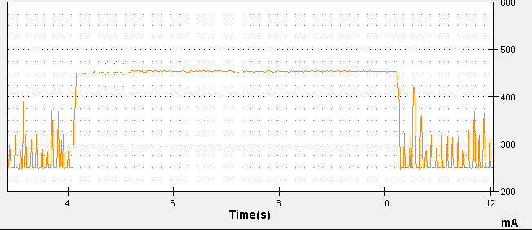
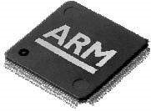
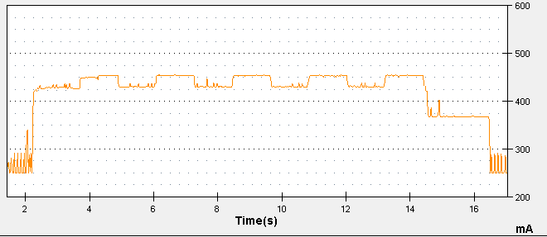
Components power consumption add linearly
WM6.5 on HTC Touch
Send
start
Send done
Spin_CPU
Spin_CPU Stop
Socket close
+200mA
+180mA
+110mA
Send(10mb);
sleep();
Socket.close();
Spin_CPU(2M)
(i = 1)
(2) Spin_CPU(10M);
Send(2mb)
(i = 5)
Spin_cpu(2M)
(i = 5)
Send(2mb)
(i = 1)
(3)
for (i in 1 to 5){
Send(2mb);
Spin_CPU(2M);
}
Sleep();
Socket.close();
+200mA
+110mA
+180mA
Socket close
Network tail
Notes:
Devices do interact in terms of energy
Send 10 mb of data 180mA (2) spin CPU for 10 million cycles 200mA
(3) 180 – 200 – 180 – 200 – When the last CPU spin is over, 110mA.

Slide 16
What have we learnt so far?
Simple (state-of-art) energy modeling assumptions are wrong
There exits a notion of power states
What have we hinted so far?
Device drivers have intelligent power control rules
System calls play a role in power consumption
Challenges in fine-grained power modeling?
Device drivers are closed source (no code/no information)

Slide 17
System Calls As Power Triggers
Key observation: System call is the interface through which an application communicates with the underlying system (hardware) and outside world (Internet, GPS, etc.)
Key Idea: Use System Calls as triggers in power modeling
Advantages:
Encapsulates utilization based triggers
Parameters of system calls
Captures power behavior of ones that do not necessarily imply utilization
Can be traced back to process, thread, function
Eases energy accounting

Slide 18
Finite-State-Machine (FSM) as Power Model Representation
We Use Finite-State-Machine (FSM)
Nodes: Power states
Base State: No activity on phone
Productive state: Actual utilization
Tail state: No-useful work
Edges: Transition rules
System calls (start/completion)
Workload (Ex: 50 pkts/sec)
Timeout
State 1
Transitions
State 2
State 3

Slide 19
FSM Power Model Construction
Systematic ‘Brute Force’ Approach
Step 1 : Model Single System Call
Step 2 : Model Multiple System Calls for Same Component
Step 3 : Model Multiple Components (Entire Phone)
Requires domain knowledge
Semantics of system calls

Slide 20
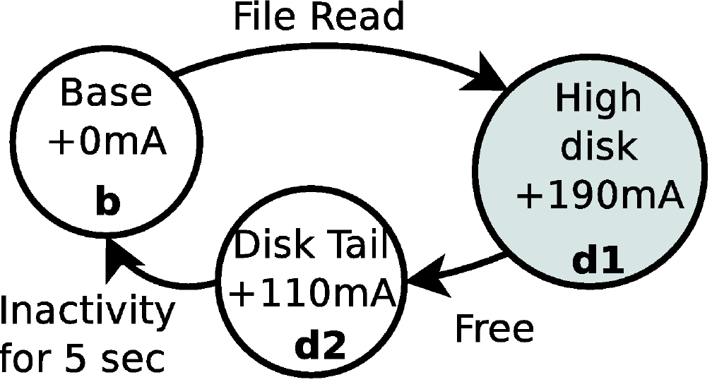
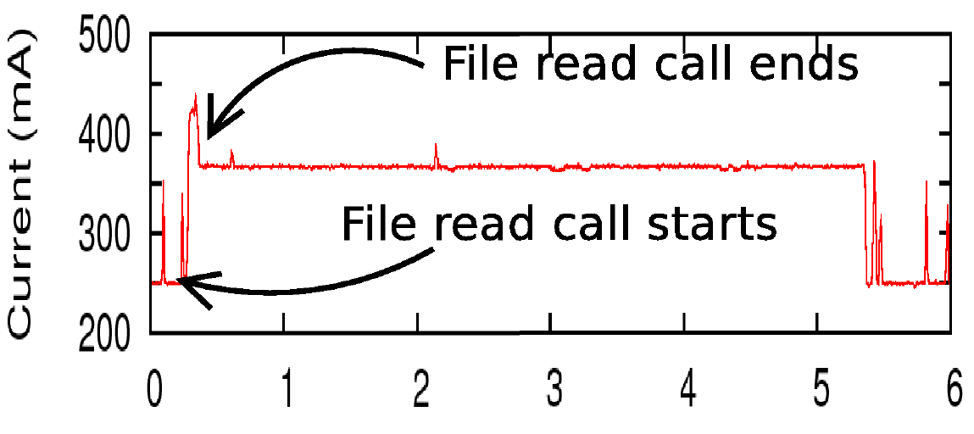

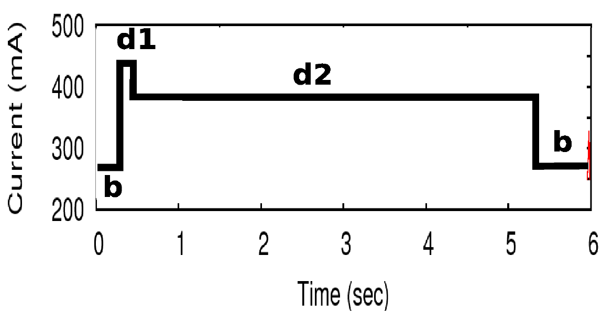
Step 1: Single System Call FSM
WM6.5 on HTC Touch
System call: read (fd, buf, size);
Measured power consumption + system calls (trigger)
Modeled power consumption
FSM

Slide 21
Step 2: Modeling Multiple System Calls of Same Component
Observation: A component can only have a small finite number of power states
Methodology
Identify and merge similar power states
Obey programming order
Model concurrent system calls

Slide 22
Step 2: WiFi NIC
WM6.5 on HTC Tytn II
Send < 50
Pkts/sec
SEND
Base State +0mA
Low Net
+125 mA
Base State +0mA
Socket close
CLOSE
Send done
Send > 50
Pkts/sec
Socket close
Net Tail
+280 mA
High
Net
+325 mA
Net Tail
+280 mA
Send
Send done
Send < 50
Pkts/sec
Base State +0mA
Low Net
+125 mA
Send done
Socket close
Send > 50
Pkts/sec
Socket close
High
Net
+325 mA
Net Tail
+280 mA
Send
Send done

Slide 23
Step 3: Modeling Multiple Components
Observation: Different components may interact with each other’s power consumption
Methodology
Try to reach different combination of states
Construct new states and transitions in FSM

Slide 24


Implementation
Windows Mobile 6.5
Extended CeLog
Android
System Tap: Logs kernel events
Android debugging framework: Custom logging in Dalvik VM

Slide 25
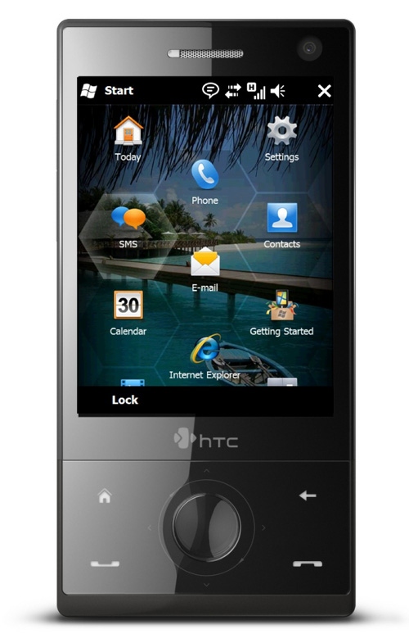
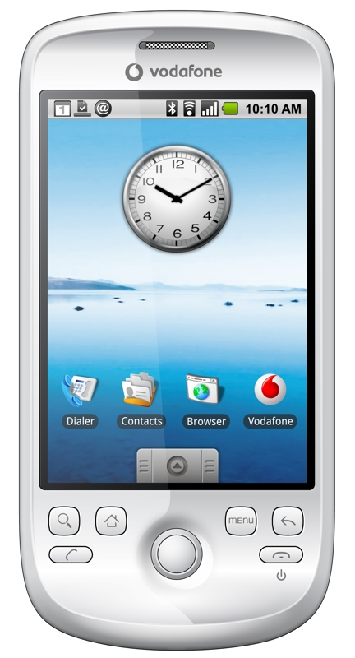
Evaluation: Handsets Used
HTC Tytn II | HTC Touch | HTC Magic
Win 6.5 (CE 5.2) | Win 6.5 (CE 5.2) | Android (Linux 2.6.34)

Slide 26
Snapshot of FSM for Entire Phone
Net Tail + CPU
+300 mA
High CPU
+130
mA
CPU
CPU (ctx_in) ctx_out
WM6.5 on HTC Tytn II
Send < 50
Pkts/sec
Base State +0mA
Low Net
+125 mA
Net Tail
+270 mA
High
Net
+325 mA
Send
Send done
Send > 50
Pkts/sec
Send done
Disk: Read /write/open/close/create/delete
Timeout 1.7s
Timeout 3s
High Disk
+125
mA
Disk Tail
+75
mA
DTail+ CPU
+130
mA
Disk
Call completed
CPU

Slide 27
End-To-End Energy Estimation Error
FSM: under 4%
LR: 1% – 20%
Notes:
Say what are applications

Slide 28
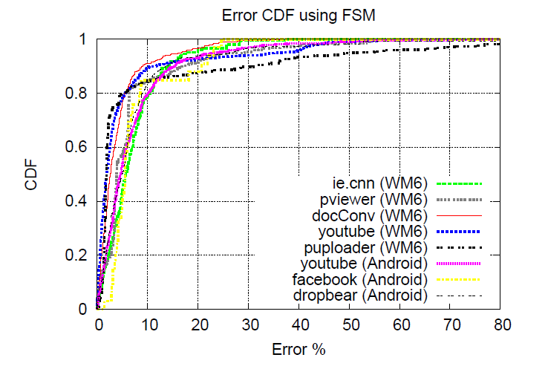
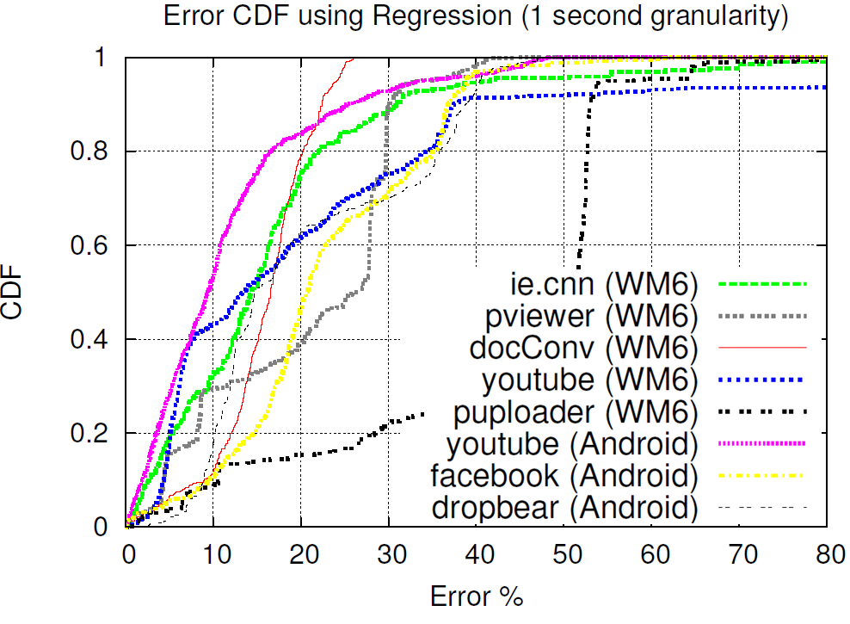
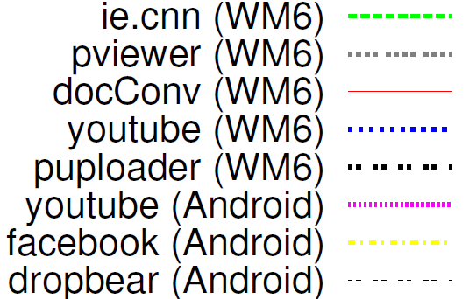
Fine-Grained Energy Estimation
CDF of energy estimation error per 50ms time interval
FSM based on System calls | Linear Regression (State-of-art)
FSM: 80th percentile error less than 10% for all apps
LR: 10th percentile error less than 10% for all apps
Notes:
What to say here
Make fig fonts larger

Slide 29
Paper Contains …
Detailed FSM construction
Handling special cases (CPU Frequency, WiFi Signal Strength)
FSM for 3 smartphones
Detailed Accuracy Results
Why our model performs better than state-of-art
Logging Overhead
Under 10% overhead on both the OSes
Application: Energy Profiler
Call-Graph Energy profiler for smartphone apps
Generates source code heat map

Slide 30
Eprof: Energy Profiler
Problem
Measure per function (thread/process) energy consumption of an application
Challenge
Correct energy accounting (tail energy, component interaction)
Approach:
Build FSM power models
Syscalls can be traced to process/thread
Manual or compiler-assisted marking of function boundaries
Notes:
Use pinning to handle tail side-effects

Slide 31
Main Contributions
Developed fine-grained energy modeling: Predicts fine grained energy consumption using FSM of mobile applications
Implemented on Windows Mobile 6.x and Android
Demonstrated improved accuracy in fine-grained energy estimation over state-of-art utilization based models

Slide 32
Power Guru: Implementing Smart Power Management on the Android Platform
Hans Fredrik Unelsroed, UCSD, 2011
A smart power management system for the Android OS that makes multi-tasking more battery friendly.
We do this by looking at the currently running applications and asking the user which applications he/she wants to prioritize and then makes suggestions on which applications should be killed in order to maximize the remaining battery life.
Notes:
by asking the user which applications
he/she wants to prioritize and then makes suggestions on
which applications should be killed in order to maximize the
remaining battery life.

Slide 33
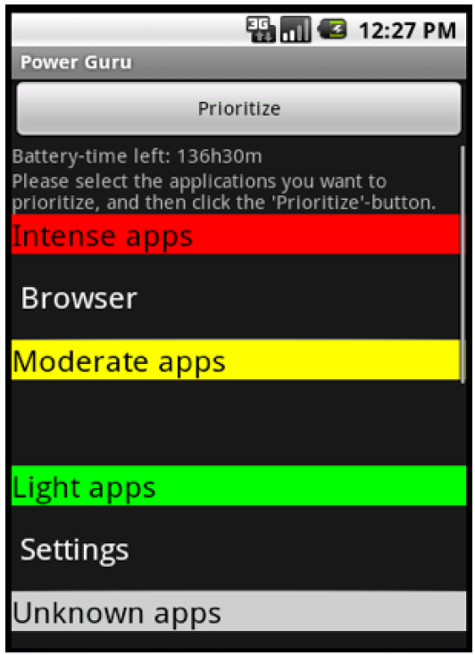
Power Guru GUI

Slide 34
References
Hans Fredrik Unelsroed et al,

